Slide 1
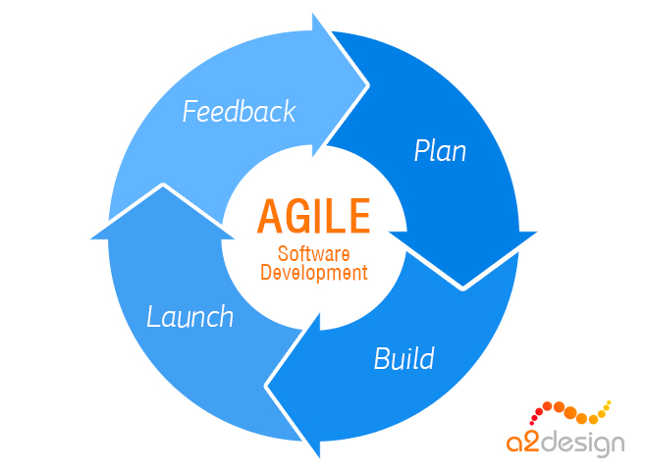

Agile Software Development Project
Development of a Sharded NoSQL Database Using MongoDB
Team B:
Mejda Allani
Vishali Valluri
Hugh Moran
Pat Mc Donnell

Slide 2
Presentation Overview
NoSQL databases, agile scrum process, installation of MongoDB (Vishali)
Structure and configuration of MongoDB sharded database (Pat)
Importing dataset and database model (Hugh)
CRUD operations (Mejda)
Conclusions (Mejda)

Slide 3

Agile Scrum Process for Our Project

Slide 4
Need For NoSQL Databases
The emergence of cloud computing
The need to store unstructured data
Agile Development Methods

Slide 5
A NoSQL database provides a mechanism for storage and retrieval of data that is modelled in means other than the tabular relations used in relational databases (like SQL, Oracle, etc.).
Types of NoSQL databases:
• Key Value
• Graph
• Column Oriented
• Document Oriented

Slide 6
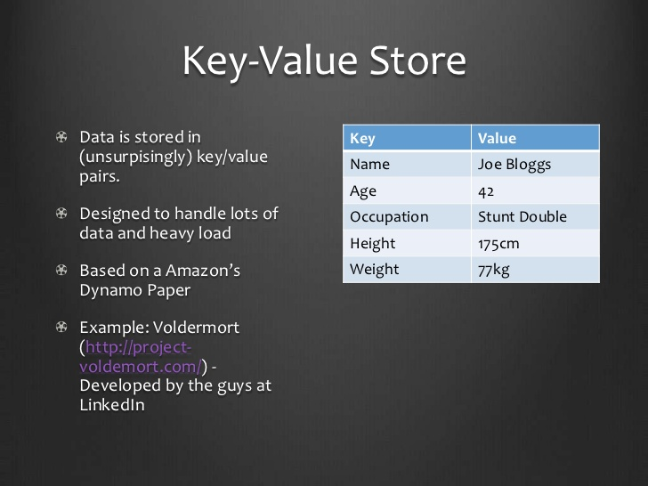

Slide 7
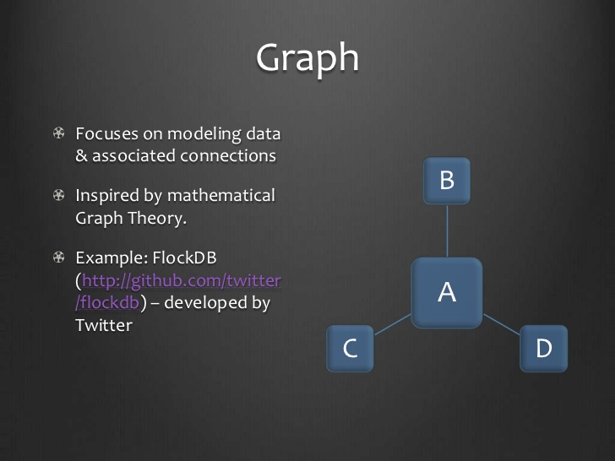

Slide 8
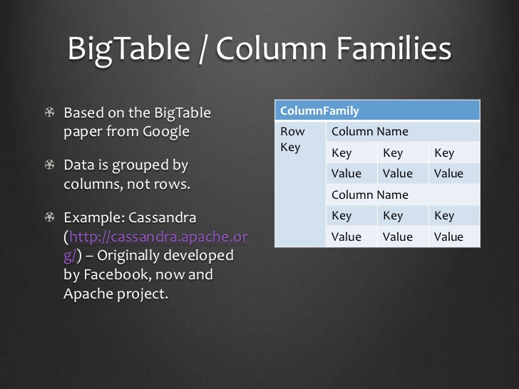

Slide 9
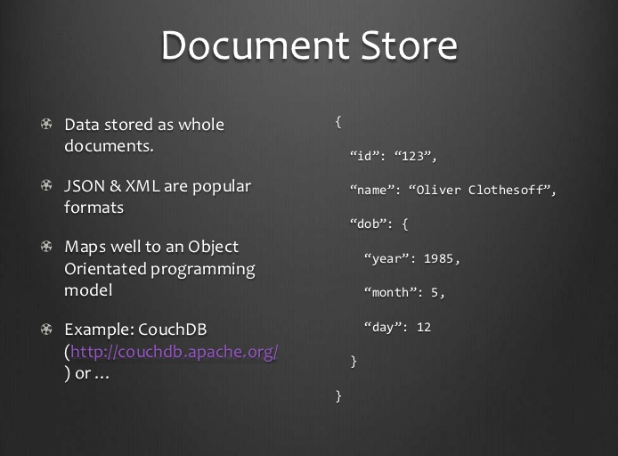

Slide 10
MongoDB is a document oriented database. It stores data in the form of BSON structure based documents. These documents are stored in a collection
Features of MongoDB
• Flexible data model in form of documents
• Agile and highly scalable database
• Faster than traditional databases
• Expressive query language

Slide 11
Date | Members present | Discussion/Tasks
Feb 22nd | Pat, Vishali, Majda, Hugh | Setup MongoDB on Azure reference Mejda’s "mongod on Azure.txt" on dropbox - Reasearch Sharding - Hash Based - Reasearch Synchronization
Feb 25th | Pat, Vishali, Majda, Hugh | - Sample Data Set Bank or other - Attempt sharding and the parameters that are involved in it
Feb 29th | Pat, Vishali, Majda, Hugh | * Azure Cloud Names: - Ubuntupat.cloudapp.net - Vishali.cloudapp.net - Mejda.cloudapp.net Hugocloud.cloudapp.net 1 Config Server Majda 1 Router Vishali 2 Sharding Servers Hugh/Pat - Get Bigger Dataset - Upload dataset to Azure

Slide 12
Agile scrums for our project
Date | Members present | Discussion/Tasks
Feb 8th | Pat, Vishali, Majda, Hugh | - Research Key value store: Pat - Document Store: Vishali - Advantages of Hashing: Majda - Transactions in NoSQL: Hugh
Feb 11th | Pat, Vishali, Majda, Hugh | - CRUD: Create, Read, Update, Delete - Consistency in noSQL - ACID Transaction - ATOMIC Transaction
Feb 15th | Pat, Vishali, Majda, Hugh | - Learn how to CRUD - Documents Structure and what the collection looks like when inputted
Feb 18th | Pat, Vishali, Majda, Hugh | - Look at the Sub-docs for transactions - Each got two clients to input onto own machine

Slide 13
Date | Members present | Discussion/Tasks
Mar 3rd | Pat, Vishali, Majda, Hugh | Try get Shards working on test_db Involving enabling sharding on the collection and database
Mar 7th | Pat, Vishali, Majda, Hugh | - Know how to CRUD the sharded Database test_db - Folder available on Dropbox - Presentation divided into 5 sections 1. Agile Scrums in the project ? 2. Installing MongoDB/Robomongo: Vishali 3. Config the shards /sync/hash keys: Pat 4. Importing/exporting data to Azure: Hugh 5. CRUD operations: Majda

Slide 14
Date | Members present | Discussion/Tasks
Mar 10th | Pat, Vishali, Majda, Hugh | - Presentation - 1/2 hour presentation - 15 mins demo + questions - What is in Router/Shards/Config server - CRUD on the Shards - Explain the business rules the database
Challenges:
- When importing the large Database
When sharding the database
When setting up the whole configuration

Slide 15
Installation of MongoDB on Ubuntu 14.04
Step 1 — Importing the Public Key
In this step, we will import the MongoDB GPG public key.
so we first have to import they key for the official MongoDB repository.
To do so, execute:
sudo apt-key adv --key server hkp://keyserver.ubuntu.com:80 --recv 7F0CEB10
Step 2 — Creating a List File
Next, we have to add the MongoDB repository details so APT will know where to
download the packages from. Issue the following command
to create a list file for MongoDB.
echo "deb http://repo.mongodb.org/apt/ubuntu "$(lsb_release -sc)"/mongodb-org/3.0 multiverse“
| sudo tee /etc/apt/sources.list.d/mongodb-org-3.0.list

Slide 16
After adding the repository details, we need to update the packages list.
sudo apt-get update
Step 3 — Installing and Verifying MongoDB
sudo apt-get install -y mongodb-org
This command will install several packages containing latest stable version of MongoDB along with helpful management tools for the MongoDB server.
After package installation MongoDB will be automatically started. You can check this by running the following command.
service mongod status

Slide 17
if MongoDB is running, you'll see an output like this (with a different process ID).
Output
mongod start/running, process 1611
You can also stop, start, and restart MongoDB using the service command (e.g. service mongod stop,service mongod start).

Slide 18
Configuration of Sharded Database
Purpose of sharding:
Capacity of a single server may not be enough
High query rates can exhaust CPU capacity of server
Sharding distributes the data over multiple servers or shards
Collectively, shards make up a single logical database

Slide 19
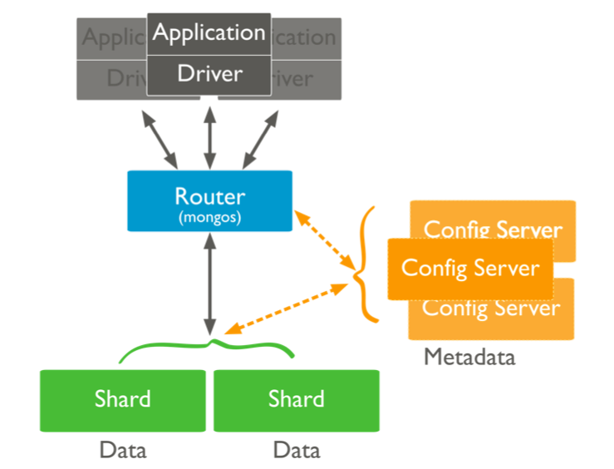
Configuration of Sharded Database
RoboMongo for our project
Vishali’s virtual machine
Mejda’s virtual machine
Pat’s VM
Hugh’s VM

Slide 20
Configuration of Sharded Database
Client applications never communicate directly with shards – only with Router
Router tracks what is on each shard by caching metadata from Config Server
Router routes queries to appropriate shard and returns results
Config Server metadata includes list of chunks on every shard and the ranges of the hash keys that define the chunk

Slide 21
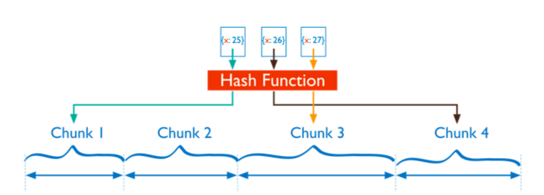
How the Data is Sharded
Shard key is a chosen as a field that exists in every document in the collection
Hash-based sharding: hash value is calculated for the field value
Data is divided into “chunks” of documents (64 Mbytes)
Chunks are distributed across the shards according to the hash value

Slide 22
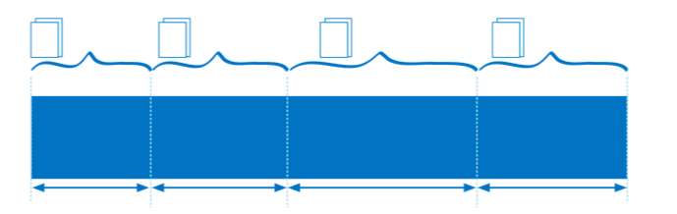
Shard Key
Shard key determines distribution of documents among the shards
Data is partitioned using ranges or chunks of shard key values
Chunks are distributed among the shards
For hashed keys, the key value you choose should have good cardinality
This ensures even (random) distribution of the data in the cluster
Random distribution ensures even distribution of queries, inserts etc

Slide 23
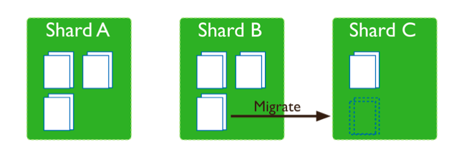
Balancing of the Cluster
Balancer is a background process
It migrates chunks from shard that has largest number of chunks to shard that has least number of chunks.
In MongoDB, you must activate the Balancer

Slide 24
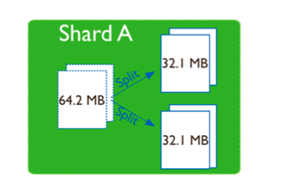
Balancing of the Cluster
Splitting
Splitting is a background process
When chunk gets too large it is split it in half
During splitting, no data is migrated to other shards

Slide 25
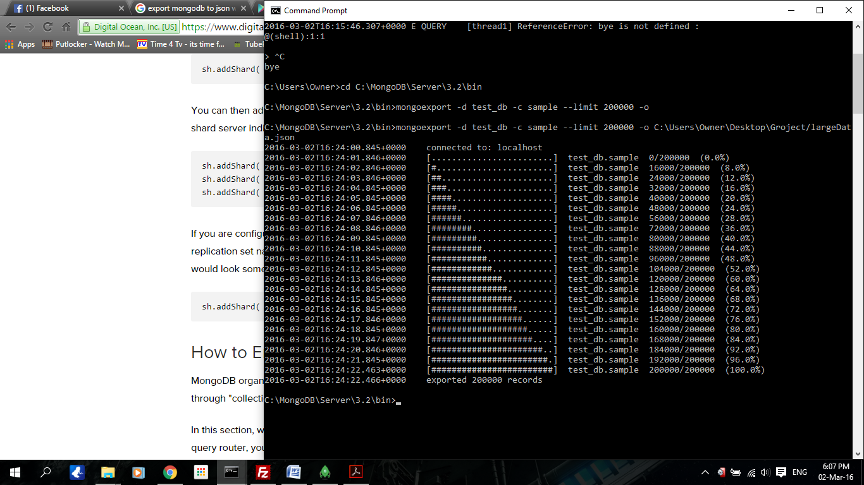
Importing Data Set
Imported a Large Data Set CSV File
Command prompt
mongoimport -d test_db -c sample
C:\Users\Owner\Desktop\ Crimes_-_2001_to_present.csv
Mongoexport –d sample –-limit 200000 –o
C:\Users\Owner\Desktop\Groject\largeData.json

Slide 26
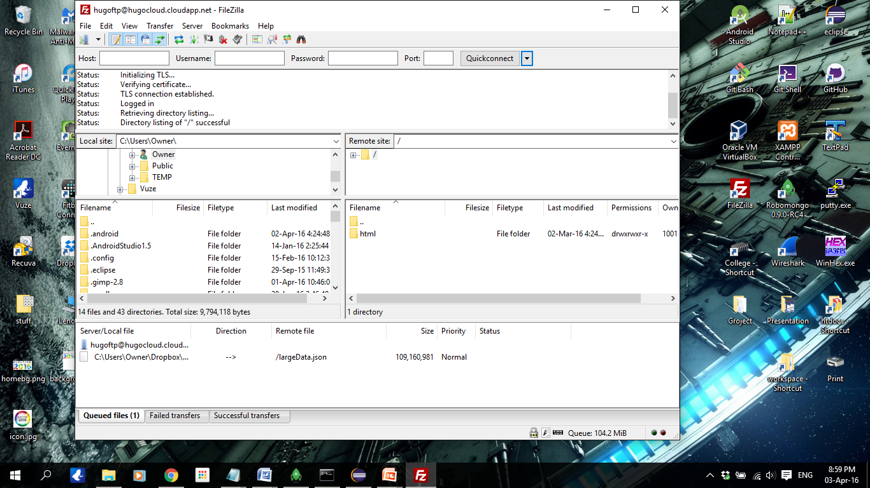
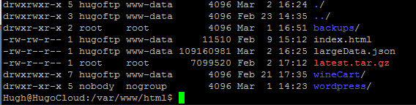
Importing Data Set
200000 entries, 104 MB file size
FileZilla used to transfer the .json file to the azure cloud
Change directory into cd /var/www/html/
Once in you can begin importing the file into Mongo

Slide 27
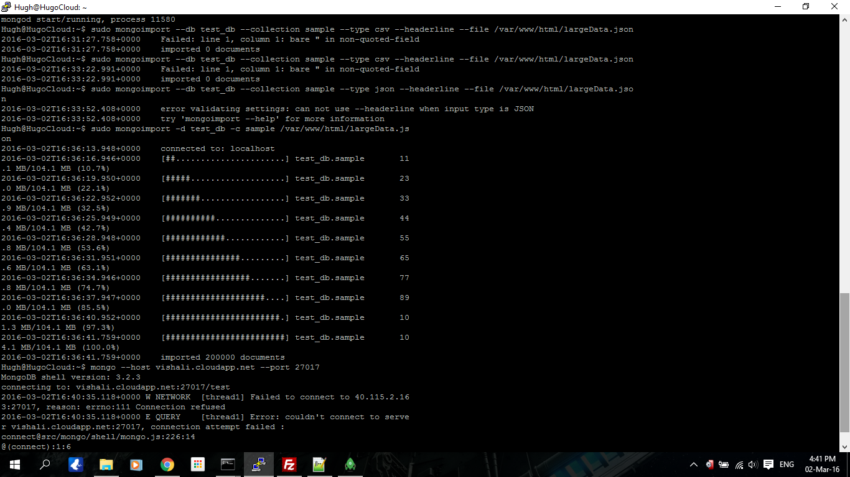
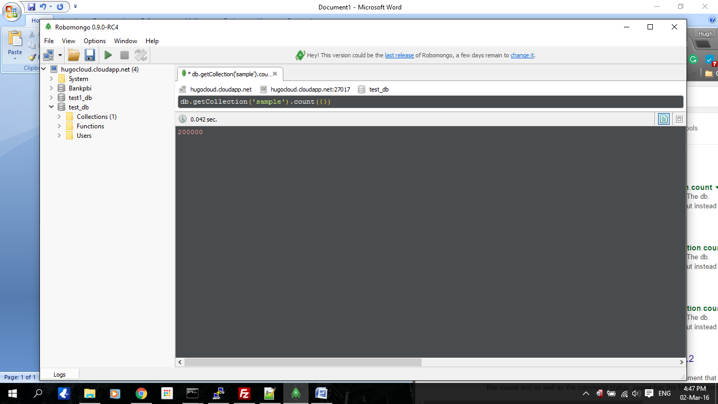
Importing Data Set
To begin importing into mongo
sudo mongoimport –d test_db –c
sample /var/www/html/largeData.json
Once imported it can be checked
Db.getCollection(‘sample’).count({});

Slide 28
Implementing Sharding
To implement Sharding
Chose the data base you wish to shard “use test_db”
sh.enanleSharding(“test_db”)
To begin sharding the collection
Youn need to hash the _id
sh.shardCollection(“test_db.sample”, { “_id”: “hashed” } )
db.sample.ensureIndex( { _id : “hashed” } )

Slide 29
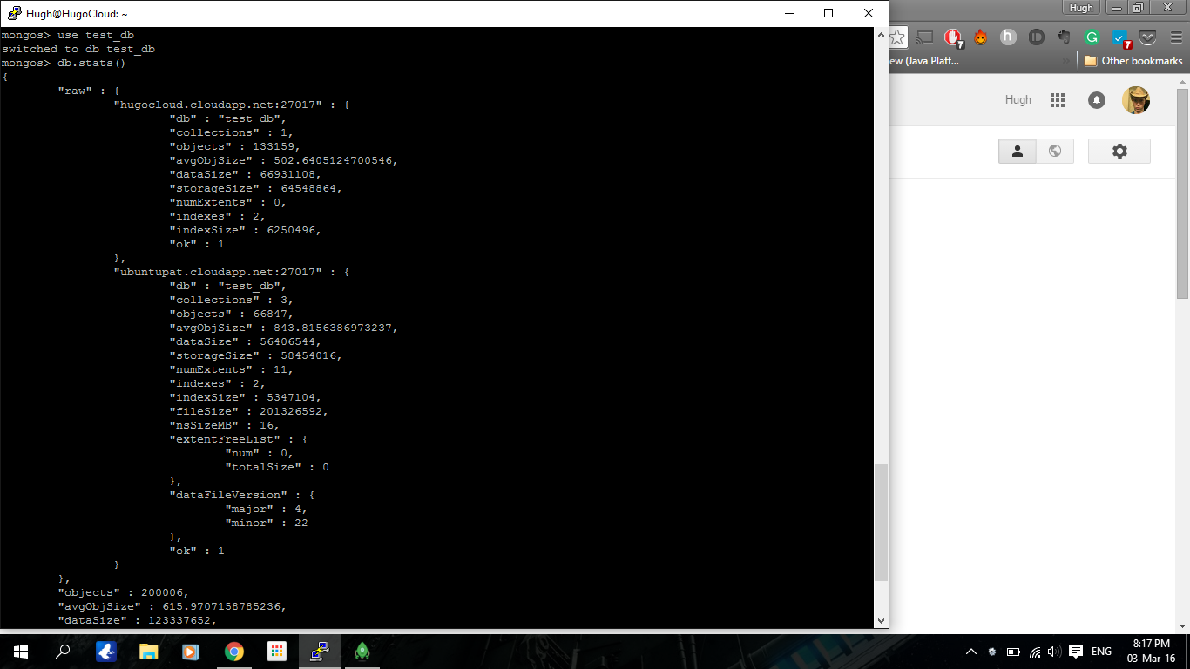
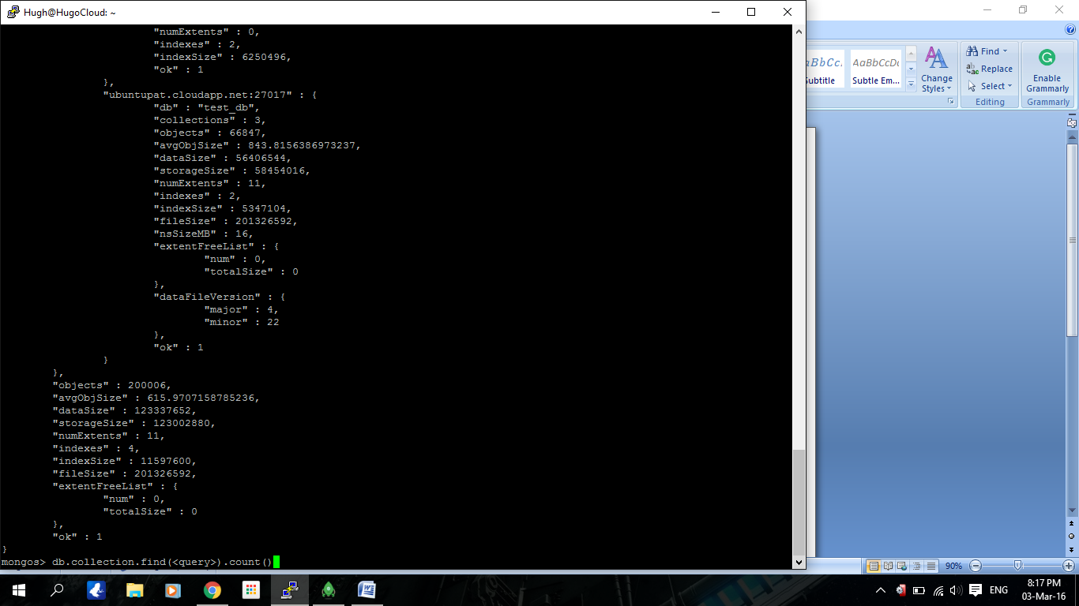
Implementing Sharding
Once completed you can
do two checks
db.stats()

Slide 30
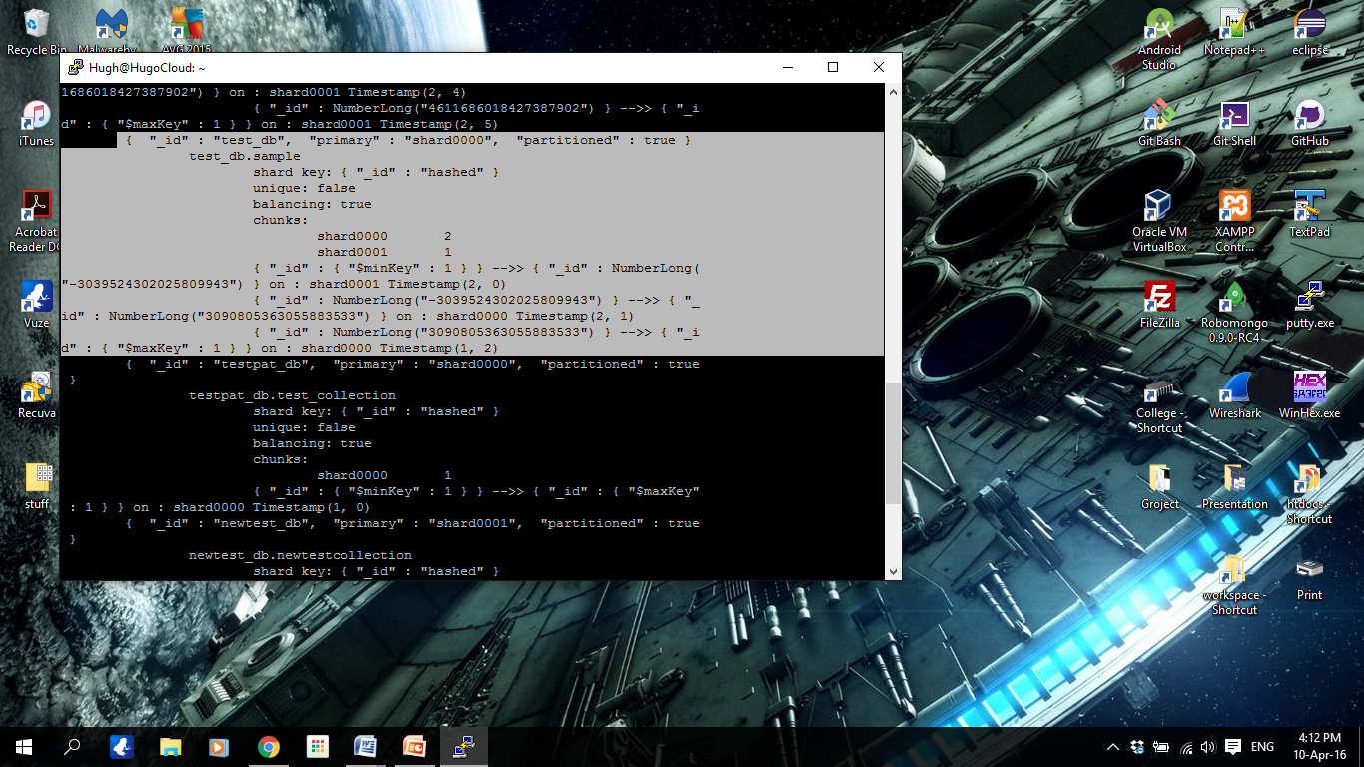
Implementing Sharding
sh.status()

Slide 31
CRUD Operations
MongoDB stores data in the form of documents, which are JSON-like field/key and value pairs, and stores all documents in collections.
{
Name:”John”,
Age:26,
Sports: [ “tennis”, “football”]
}
Field: value
Field: value
Field: value

Slide 32
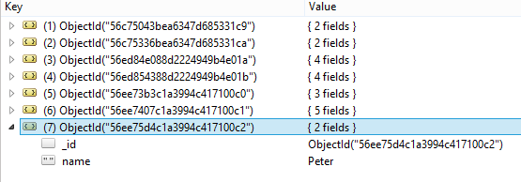
Name of the collection
1.Create:
db.getCollection(‘Students').insert({name:”Peter”}) or
db.Students.insert({name:”Peter”})
New document
New _id
Key: value

Slide 33
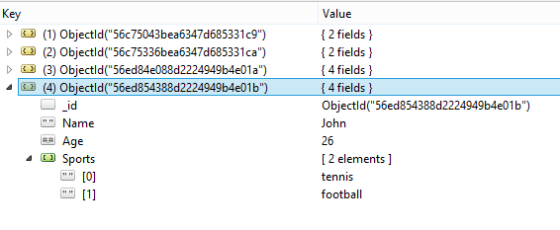
Insert an array of elements:
db.getCollection(‘Students').insert({Name:”John”, Age:26, Sports: [ “tennis”, “football”]})
Array of elements

Slide 34
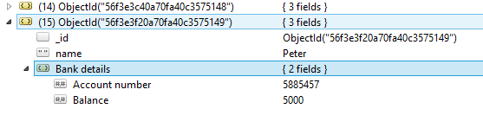
Insert a subdocument
db.getCollection('Clients').insert({name : "Peter", "Bank details" :
{"Account number" : 5885457,Balance : 5000}})
Subdocument

Slide 35
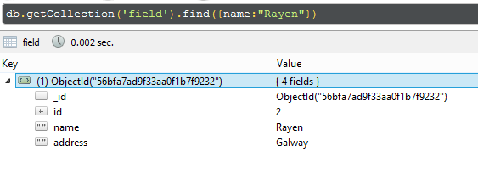
2. Search:
Db.getCollection(‘field’).find({name:”Rayen”})

Slide 36
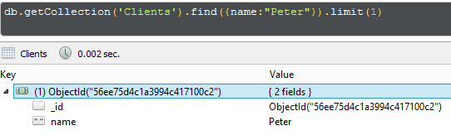
Limits:
db.getCollection(‘Clients').find({name:“Peter"}).limit(1)
If there are 2 documents that contain the searched key value, only one document will appear in the search

Slide 37
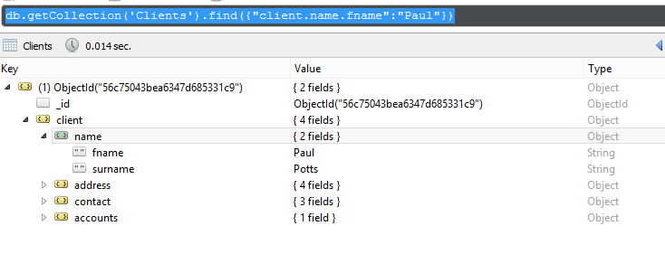
Search from a subdocument:
db.getCollection(‘Clients’).find({“client.name.fname”:“Paul”})

Slide 38
Search for multiple key-values:
db.getCollection('field').find({name:“John", job:"student"})
db.getCollection(‘Students’).find( { age: { $gt: 18 } }, { name: 1, address: 1 }).limit(5)
This query selects the documents in the students collection that match the following conditions:
Age is greater than 18.
The matching documents will return with only the _id, name and address fields.
The query returns at most 5 matching documents.

Slide 39
db.getCollection(‘Students’).find( { name: “Paul”, age: { $lt: 25 } } )
This query selects all documents where the key: name has the value: Paul.
The key age is less than 25.
Search for all documents in a collection:
db.getCollection(‘Students).find({})

Slide 40
4. Update:
db.getCollection('ObjectsInMyHouse').update(
// query
{
"name" : “TV"
},
// update
{
"name" : “Fridge"
},
// options
{
"multi" : false, // update only one document
"upsert" : true // insert a new document, if no existing document match the query
});

Slide 41
Original document
Update operation
{
_id: 150,
item: "abc123",
quantity: 250,
instock: true,
details: { model: "14Q2", make: "xyz" },
tags: [ "apparel", "clothing" ]
}
db.products.update(
{_id: 150 },
{ $set:
{ quantity: 500,
details: { model: "14Q3", make: "xyz" },
tags: [ "coats", "outerwear", "clothing" ]
} } )
The operation replaces the value of:
- quantity to 500;
- the details field to a new embedded document,
- and the tags field to a new array.

Slide 42
4. Delete:
db.getCollection(‘Students').remove({})
=> It removes all documents in the collection.
db.getCollection(‘Students').remove({name:“John”)
This removes all the documents in the collection that contain the key value: name:”John”.
db.getCollection(‘Students').remove( { name : “Peter” }, 1 )
=> This removes one the documents in the collection that contain the key value: name:”John”.

Slide 43
Conclusion
What we achieved:
Installed Mongo DB on our own machines
Learned how to perform CRUD operations
Set up a sharded database configuration on 4 virtual machines
Inserted data in sharded database
Performed CRUD operations on sharded database

